Slide 1
Programming JAVA {
Hiveed.java
JAVA PROGRAMMING ;
/* Here is where your journey for your dream begins */
}
JAVA Programming

Slide 2
Table Of ‘Contents’ {
01
02
03
Hiveed.java
Tokens ;
Datatypes ;
Variables ;
}
JAVA Programming

Slide 3
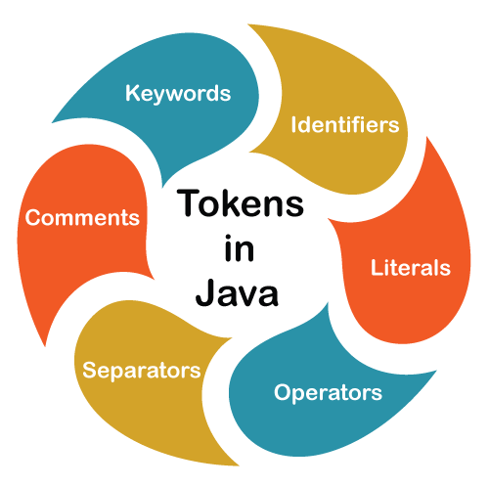
Tokens {
Hiveed.java
}
JAVA Programming

Slide 4
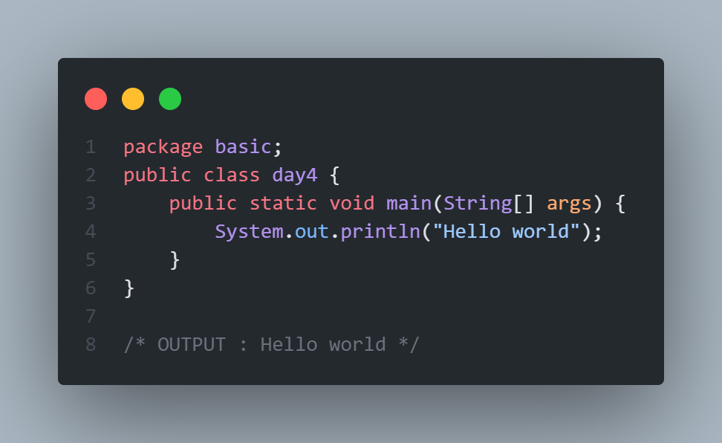
Keywords :
Hiveed.java
Java has a set of keywords that are reversed words that cannot be used as a variable , methods , classes , or any other identifiers.
Ex : package , class , static
JAVA Programming

Slide 5
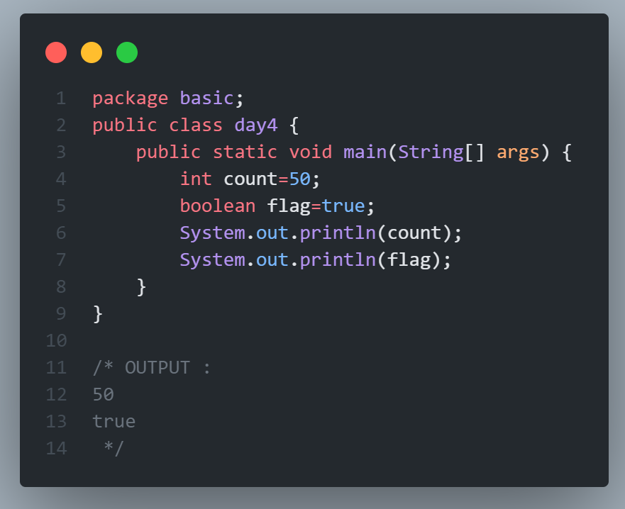
Indentifiers :
Hiveed.java
Java unique names are called identifiers.
identifers can be short names
(like x and age , sum , count).
Names can contain letters , digit ,
underscrore , and dollar signs.
Ex : package , class , static
JAVA Programming

Slide 6
Literals :
Hiveed.java
Literals in java are a synthetic represntation of boolean. character, numeric or string data They are contanst values that directly appear in program and can assigned to variable
Ex :int count=50
“int count” = integer ,‘50’ represent the literal
JAVA Programming

Slide 7
Seprators :
Hiveed.java
Separators help us defining the structure of a program In Java, There are few characters used as separators.
EX : “{”, “;”, “.”, “}”
Comments :
Single-Line Comments: Start with // and extend to the end of the line.
Multi-Line Comments: Start with /* and end with */
JAVA Programming

Slide 8
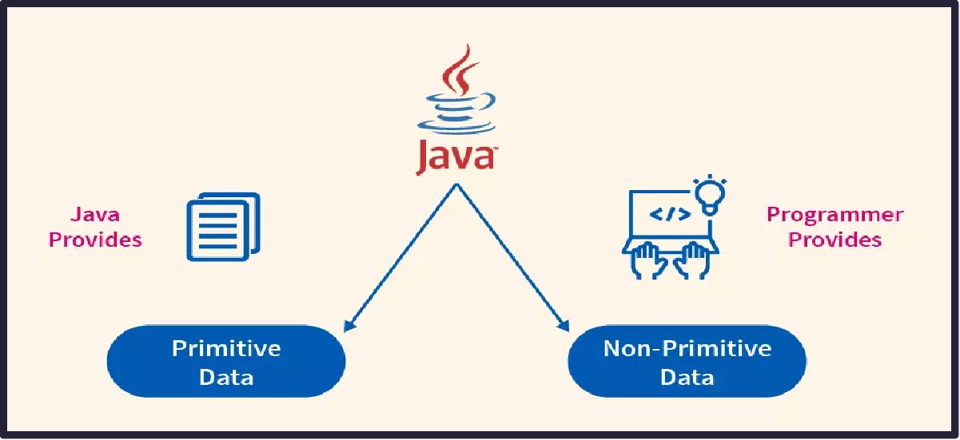
Datatypes :
Hiveed.java
JAVA Programming

Slide 9
Primitive Datatypes :
Hiveed.java
JAVA Programming

Slide 10
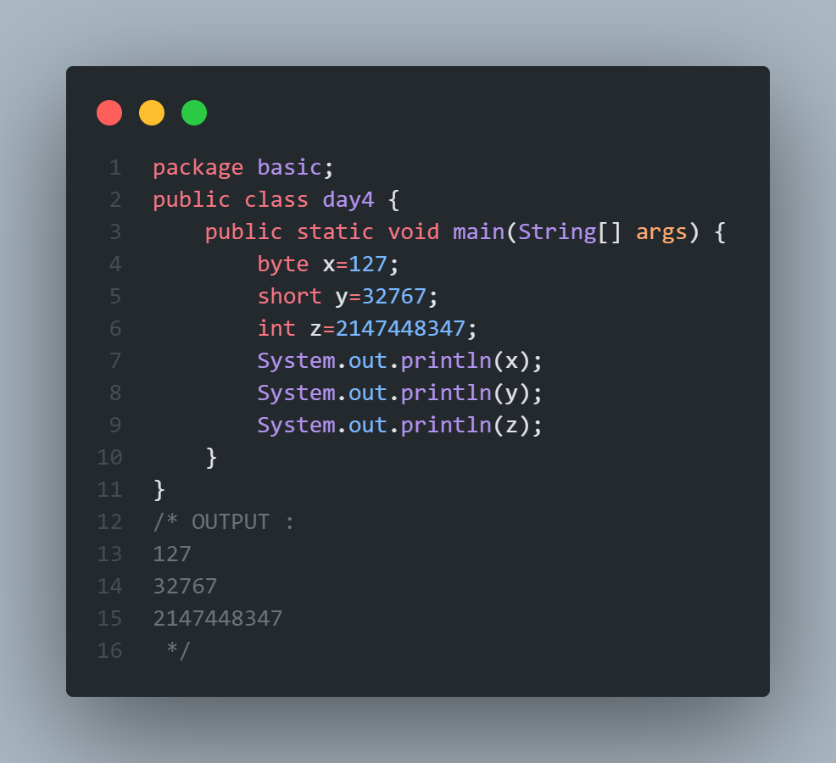
Primitive Data Types:
Hiveed.java
Bytes:
The byte keyword is a data type that can store whole numbers from -128 to 127. (1 Byte) EX : byte x=127;
Short :
The short keyword is a data type that can store whole numbers from -32,768 to 32,767. (2 Bytes) EX : short Y=32767;
int :
The int keyword is a data type that can store whole numbers The int contains minimum value of -2147483648 to 2147483647.
(4 Bytes) EX : int x=21474483647;
JAVA Programming

Slide 11
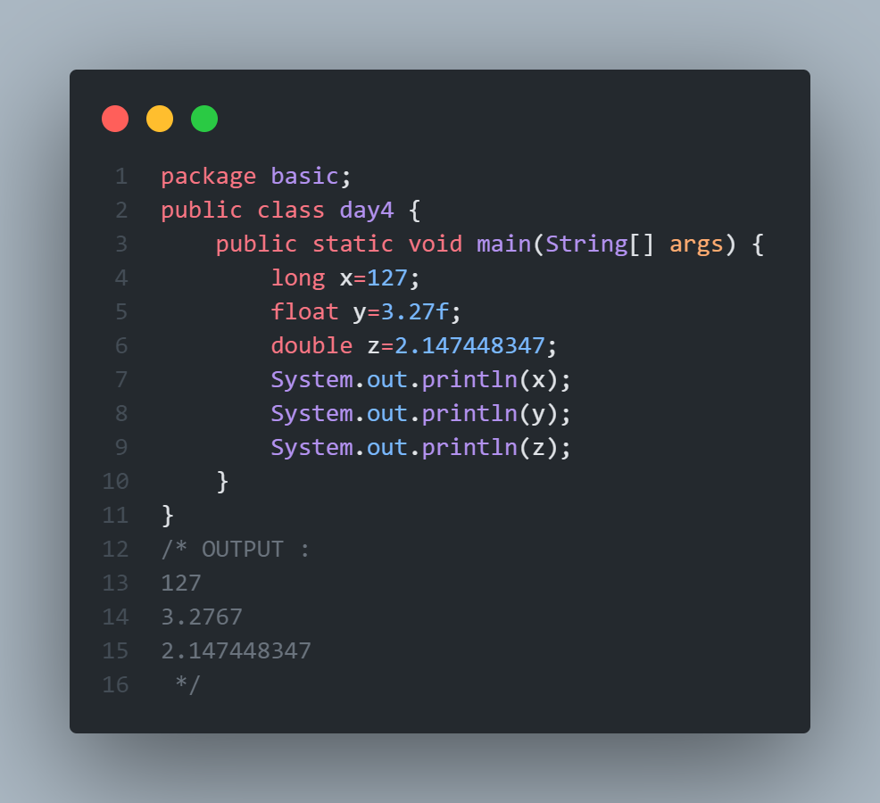
Hiveed.java
long:
Stores whole numbers from -9,223,372,036,854,775,808 to 9,223,372,036,854,775,807
(8 Byte) EX : long x=127;
Float :
Stores fractional numbers. Sufficient for storing 6 to 7 decimal digits. (2 Bytes)
EX : float Y=3.2767f
Double :
Stores fractional numbers. Sufficient for storing 15 decimal digits
EX : double z=32.564646;
JAVA Programming

Slide 12
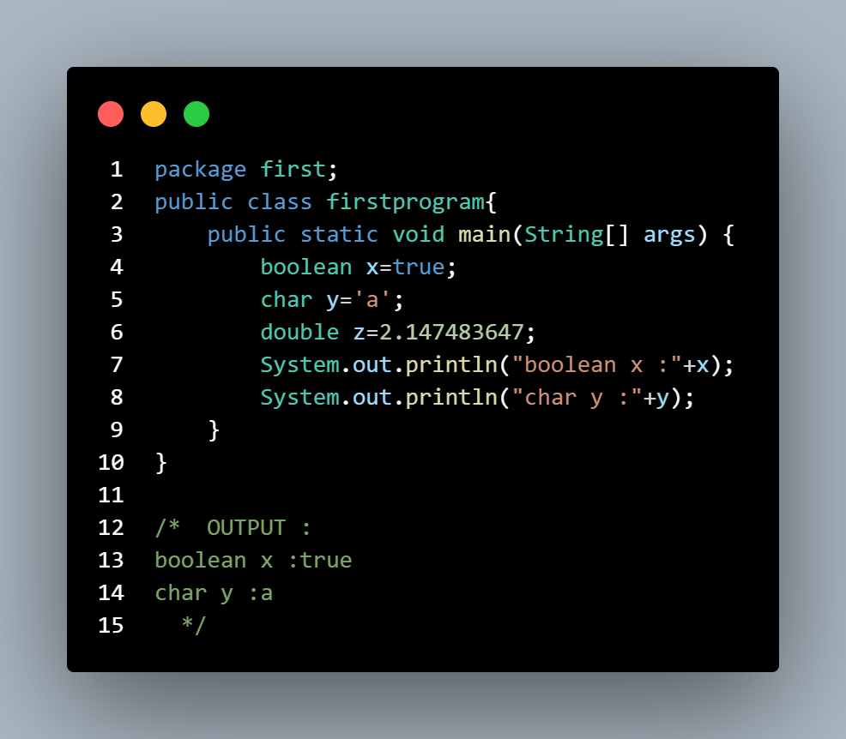
Hiveed.java
Boolean :
Stores true or false values
(1 Byte) EX : boolean x=true;
char :
Stores a single character/
letter or ASCII values.
(2 Bytes)
EX : char Y='a';
JAVA Programming

Slide 13
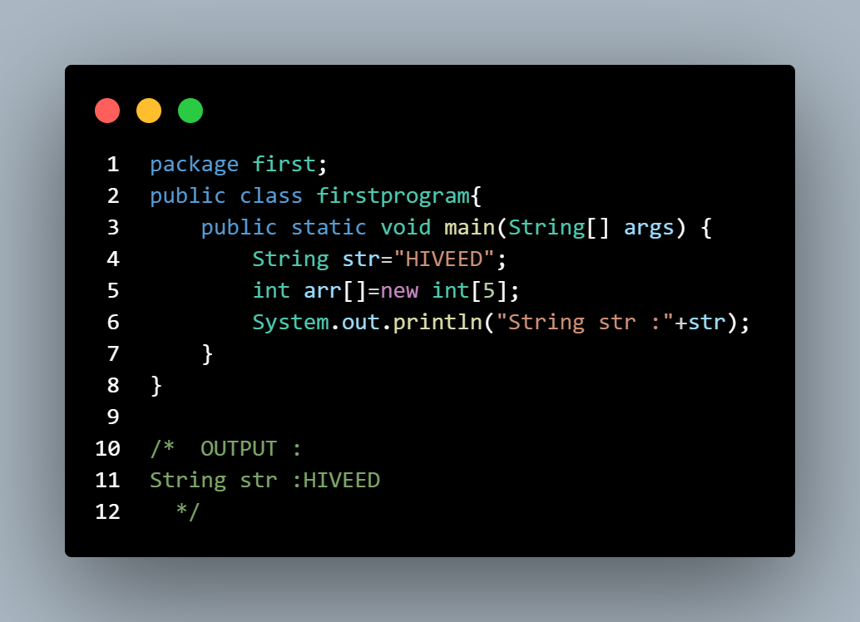
Non-Primitive Data Types:
Hiveed.java
Non-primitive types are created by the programmer and is not defined by Java (except for String).
Non-primitive data types are called reference types because they refer to objects.
EX : Strings, Arrays, Classes, Interface, etc..
JAVA Programming

Slide 14
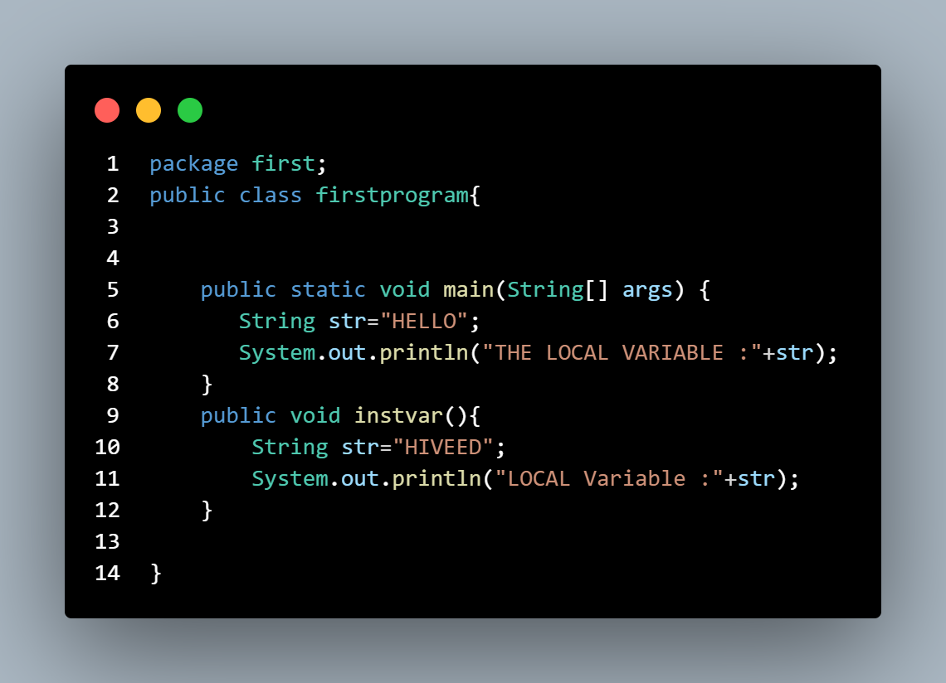
Hiveed.java
Variables :
The names used to refer to data stored in the memory.
Variables are used to identify the location of data in a program.
1. Local Variables :
A local variable starts functioning inside the block or method, but it gets destroyed when it exits the block.
JAVA Programming

Slide 15
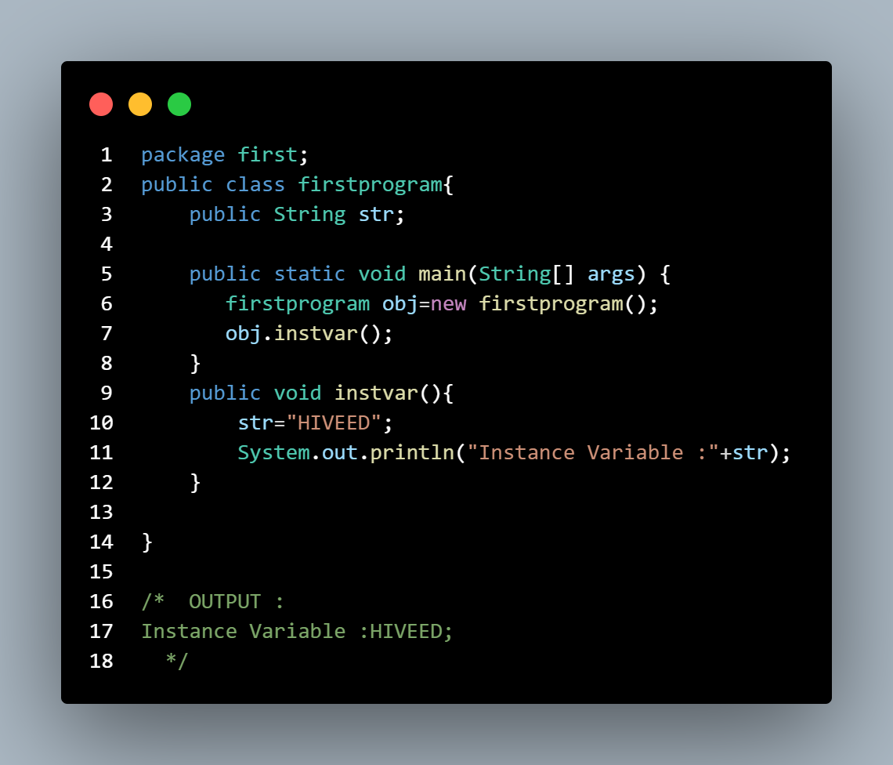
Hiveed.java
Variables :
2. Instance Variables/Global Variable :
Instance variables are non-static variables and are declared
in a class outside of any method, constructor, or block.
JAVA Programming

Slide 16
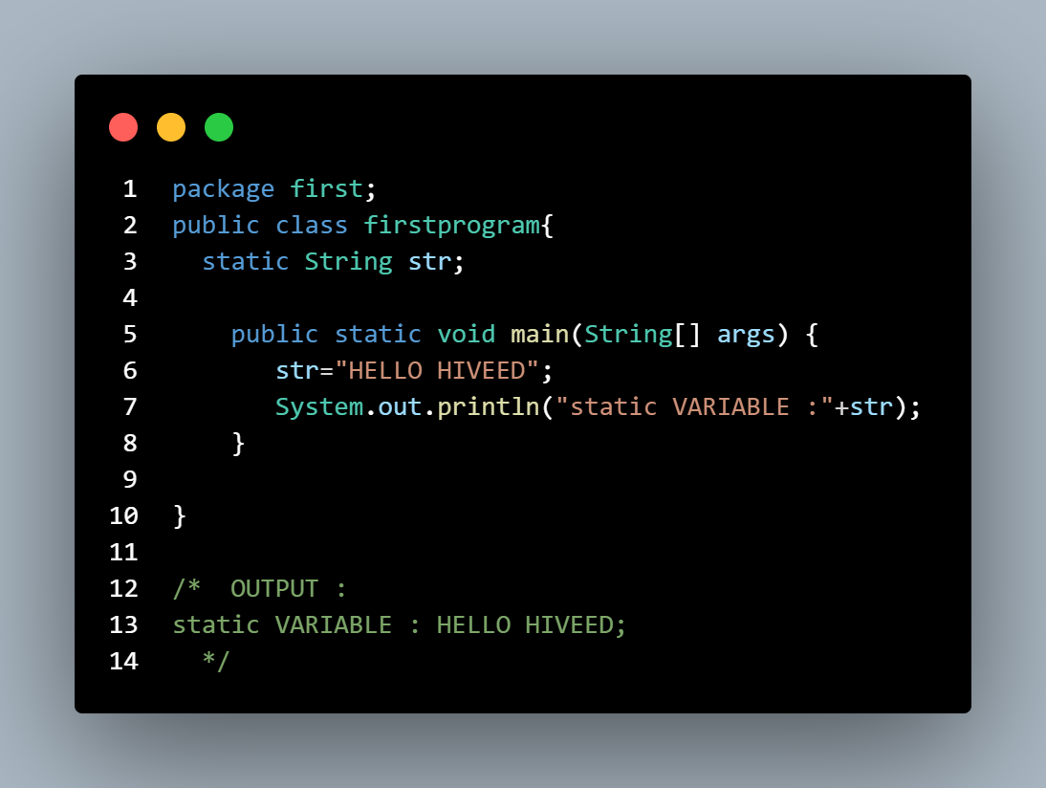
Hiveed.java
Variables :
3. Static Variables :
These variables are declared similarly to instance variables. The difference is that static variables are declared using the static keyword within a class outside of any method, constructor, or block.
Unlike instance variables, we can only have one copy of a static variable per class, irrespective of how many objects we create.
JAVA Programming

